Slide 1
電腦視覺與深度學習 (Computer Vision and Deep Learning) Homework 1
TA:胡滋紜
Gmail: nckubot65904@gmail.com
Office Hour: 14:00~16:00, Mon.
10:00~12:00, Fri.
At CSIE 9F Robotics Lab.

Slide 2
Notice (1/2)
Copying homework is strictly prohibited!! Penalty: Both individuals will receive a score of 0!!
Due date => 09:00:00, 2023/11/09 (Thu.)
Do not submit late, or the following points will be deducted:
Submit within seven days after the deadline, and your score will be reduced by half.
If you submit after this period, you will receive a score of 0.
You must attend the demonstration, otherwise your score will be 0. The demonstration schedule will be announced on NCKU Moodle.
You must create GUI, otherwise your point will be deducted.
Upload to => 140.116.154.28 -> Upload/Homework/Hw1
User ID: cvdl2023 Password: RL2023cvdl
Format
Filename: Hw1_StudentID_Name_Version.rar
Ex: Hw1_F71234567_林小明_V1.rar
If you want to update your file, you should update your version to be V2,
Ex: Hw1_F71234567_林小明_V2.rar
Content: Project folder *( Excluding the pictures ) *Note: Remove your “Debug” folder to reduce file size.

Slide 3
Notice (2/2)
Python (recommended):
Python 3.8 (https://www.python.org/downloads/)
Opencv-contrib-python (3.4.2.17)
Matplotlib 3.7.3
UI framework: pyqt5 (5.15.10)
Pytorch 2.1.0
Torchvision 0.16.0
Torchsummary 1.5.1
Tensorboard 2.14.0
Pillow 10.1.0

Slide 4
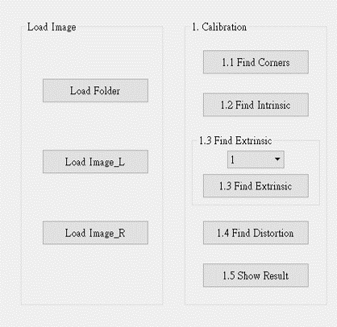
Assignment scoring (Total: 100%)
1. (20%) Camera Calibration
1.1 (4%) Corner detection
1.2 (4%) Find the intrinsic matrix
1.3 (4%) Find the extrinsic matrix
1.4 (4%) Find the distortion matrix
1.5 (4%) Show the undistorted result
2. (20%) Augmented Reality
2.1 (10%) Show words on board
2.2 (10%) Show words vertically
3. (20%) Stereo Disparity Map
3.1 (10%) Stereo Disparity Map
3.2 (10%) Checking the Disparity Value
4. (20%) SIFT
4.1 (10%) Keypoints
4.2 (10%) Matched Keypoints
5. (20%) Training a CIFAR10 Classifier Using VGG19 with BN
5.1 Load CIFAR10 and show 9 Augmented Images with Labels. (4%)
5.2 Load Model and Show Model Structure. (4%)
5.3 Show Training/Validating Accuracy and Loss. (6%)
5.4 Use the Model with Highest Validation Accuracy to Run Inference, Show the Predicted Distribution and Class Label. (6%)
(出題： Shan)
(出題：Eric)
(出題：Eric)
* Don’t fix your image path
(There is another dataset for demonstration)
Load image please use the following function to read the path.
QFileDialog.getOpenFileName
(出題：Chen)
(出題： Hsiang)

Slide 5
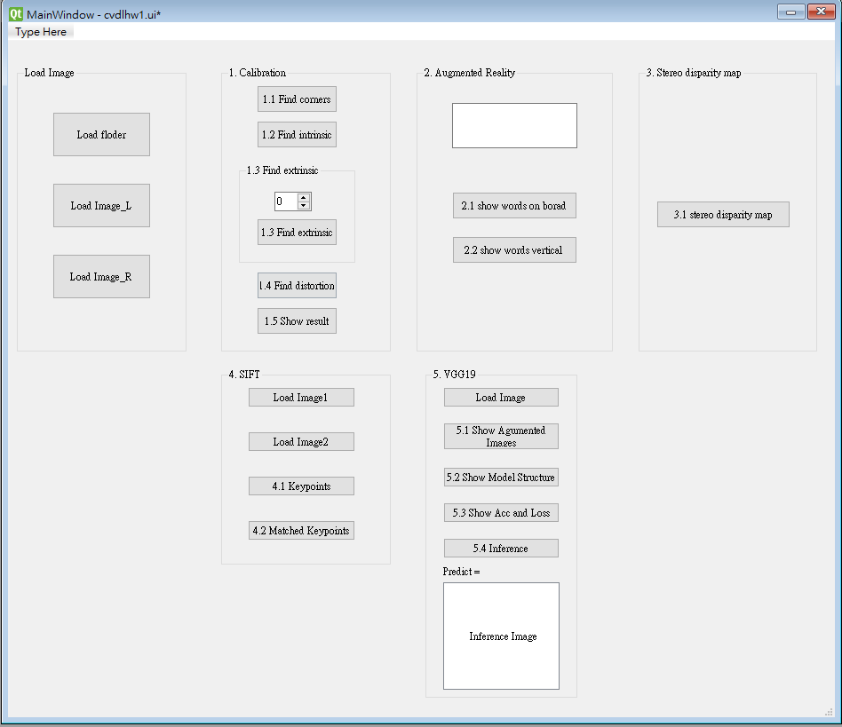
Assignment scoring (Total: 100%)
Use one UI to present 5 questions.

Slide 6
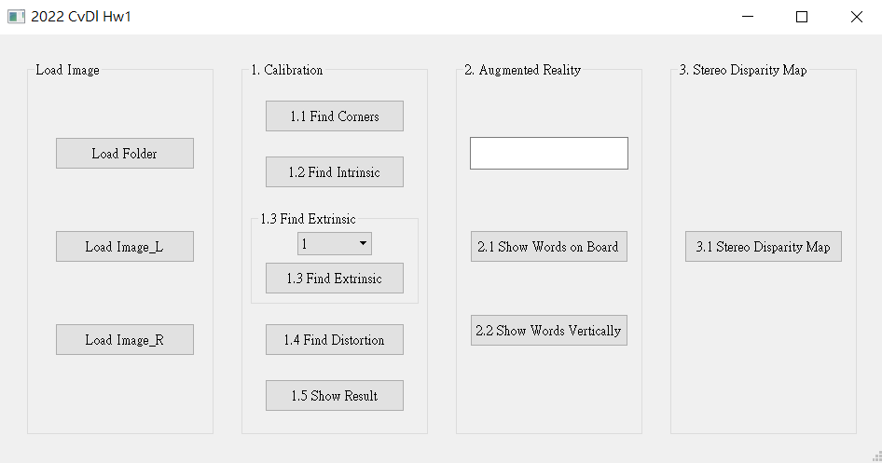
1. (20%) Camera Calibration
(出題：shan)
1.1 (4%) Corner detection
1.2 (4%) Find the intrinsic matrix
1.3 (4%) Find the extrinsic matrix
1.4 (4%) Find the distortion matrix
1.5 (4%) Show the undistorted result
Load all images in the folder

Slide 7
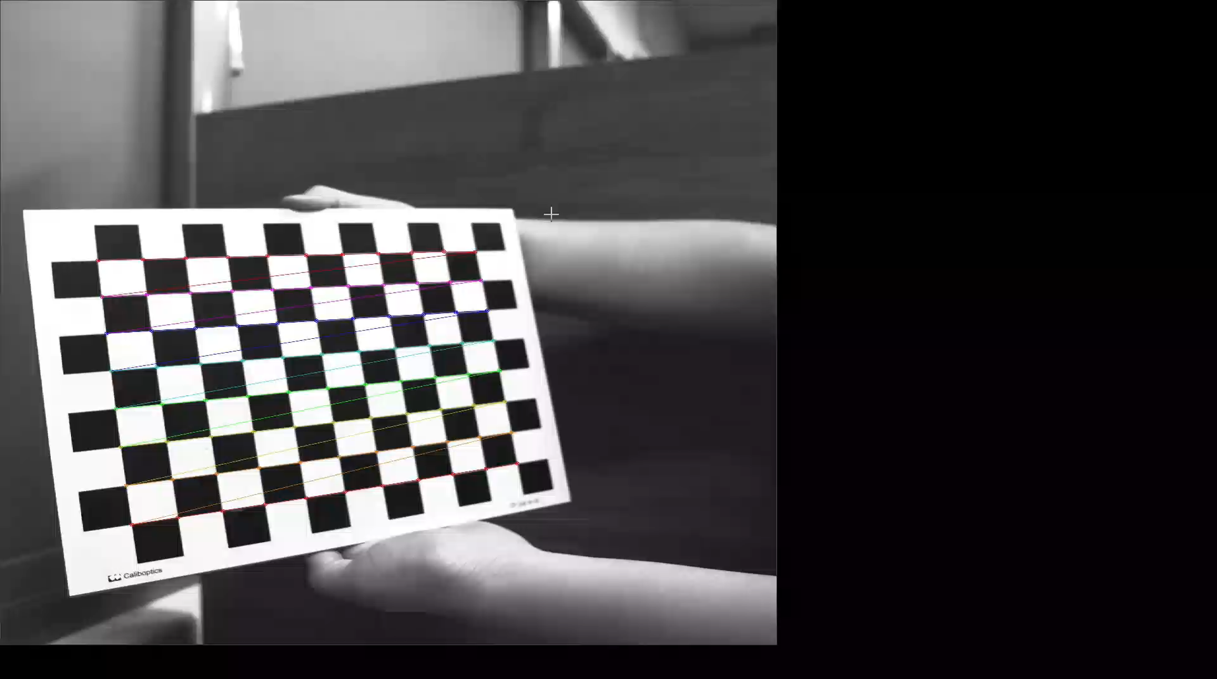
1.1 Corner Detection (4%)
(出題：shan)
Given: 15 images, 1.bmp ~ 15.bmp
Q1:
1) Find and draw the corners on the chessboard for each image.
cv2.findChessboardCorners(grayimg, (width, high), None)
cv2.cornerSubPix(image, corners, winSize, zeroZone, criteria)
winSize = (5, 5) zeroZone = (-1, -1), this parameter means to ignore.
criteria = (cv2.TERM_CRITERIA_EPS + cv2.TERM_CRITERIA_MAX_ITER, 30, 0.001)
2) Click button “1.1 Find Corners” to show each picture.
Hint:
OpenCV Textbook Chapter 11 (p. 398 ~ p. 399)
Ex:
7

Slide 9
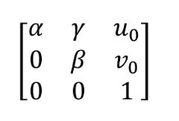
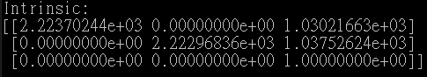
1.2 Find the Intrinsic Matrix (4%)
(出題： shan)
Given: 15 images, 1.bmp ~ 15.bmp
Q2:
1) Find the intrinsic matrix:
2) Click button “1.2 Find Intrinsic” and then show the result on the console window.
Output format:
Hint: OpenCV Textbook Chapter 11 (p.398 ~ p.400)
cv2.calibrateCamera (objectPoints, imagePoints,(width, high) ,None, None)
(Just an example)

Slide 10
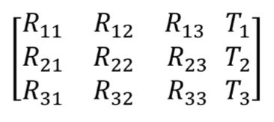
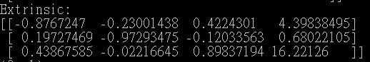
1.3 Find the Extrinsic Matrix (4%)
(出題： shan)
Given: Intrinsic parameters, distortion coefficients, and the list of 15 images
Q3:
1) Find the extrinsic matrix of the chessboard for each of the 15 images, respectively:
2) Click button “1.3 Find Extrinsic” and then show the result on the console window.
Output format:
Hint: OpenCV Textbook Chapter 11, (p.370 ~ p.402)
(Just an example)
(1) List of numbers: 1~15
(2) Select 1, then 1.bmp will be applied, and so on

Slide 11
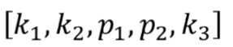
1.4 Find the Distortion Matrix (4%)
(出題： shan)
Given: 15 images
Q4:
1) Find the distortion matrix:
2) Click button “1.4 Find Distortion” to show the result on the console window.
Output format:
Hint:
Distortion coefficients can be obtained simultaneously with intrinsic.
OpenCV Textbook Chapter 11 (p.398 ~ p.400)
(Just
an example)

Slide 12
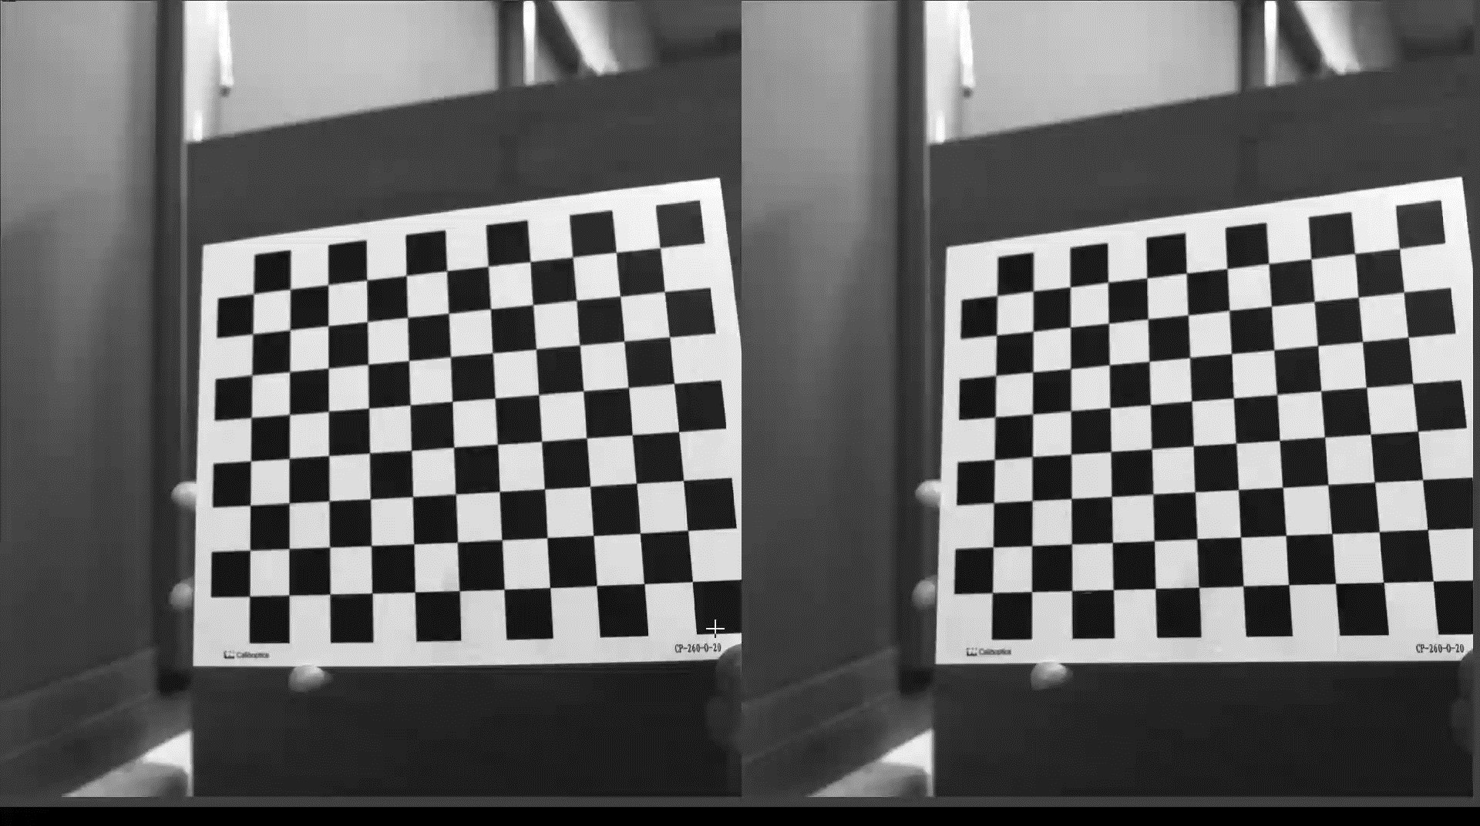
1.5 Show the Undistorted Result (4%)
(出題： shan)
Given: 15 images
Q5:
1) Undistort the chessboard images.
2) Click button “1.5 Show Result” to show distorted and undistorted images
Hint:
cv2.undistort(…) or cv2.initUndistortRectifyMap(…)
OpenCV Textbook Chapter 11 (p.398 ~ p.400)
Distorted image
Undistorted image

Slide 13
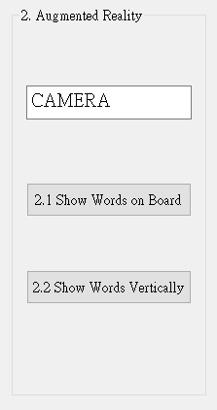
2. (20%) Augmented Reality
(出題：Eric)
2.1 (10%) Show words on board
2.2 (10%) Show words vertically
Load all images in the folder

Slide 14
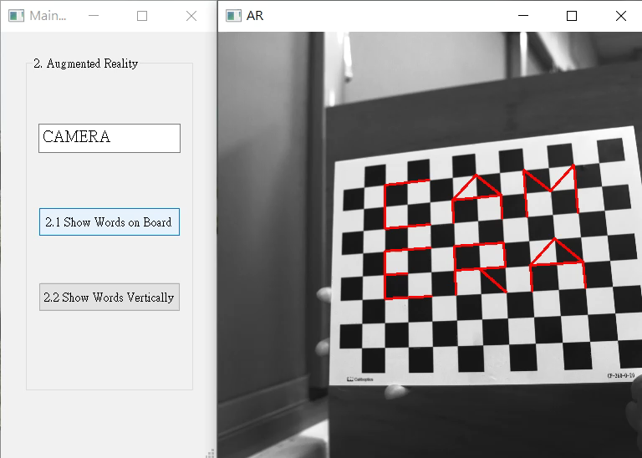
2. (20%) Augmented Reality
(出題： Eric)
Given: 5 images (1~5.bmp), alphabet_lib_onboard.txt and alphabet_lib_vertical.txt.
Q1: Show a Word (e.g. CAMERA) on chessboard
Calibrate 5 images to get intrinsic, distortion and extrinsic parameters.
Input a word less than 6 char in English in textEdit box.
Derive the shape of the word by using the provided library (alphabet_lib_onboard.txt).
Click button “2.1 Show Words on Board” to show result, each picture for 1 second (total 5 images).
Q2: Show a Word (e.g. CAMERA) vertically on chessboard
Calibrate 5 images to get intrinsic, distortion and extrinsic parameters.
Input a word less than 6 char in English in textEdit box (Accept the same word entered in as Q1).
Derive the shape of the word by using the provided library (alphabet_lib_vertical.txt).
Click button “2.2 Show Words Vertically” to show result, each picture for 1 second (total 5 images).
Result Video:
Hint: OpenCV Textbook Chapter 11 (P.387~395) cv2.calibrateCamera()
OpenCV Textbook Chapter 11 (P.405~412)
cv2.projectPoints()

Slide 15
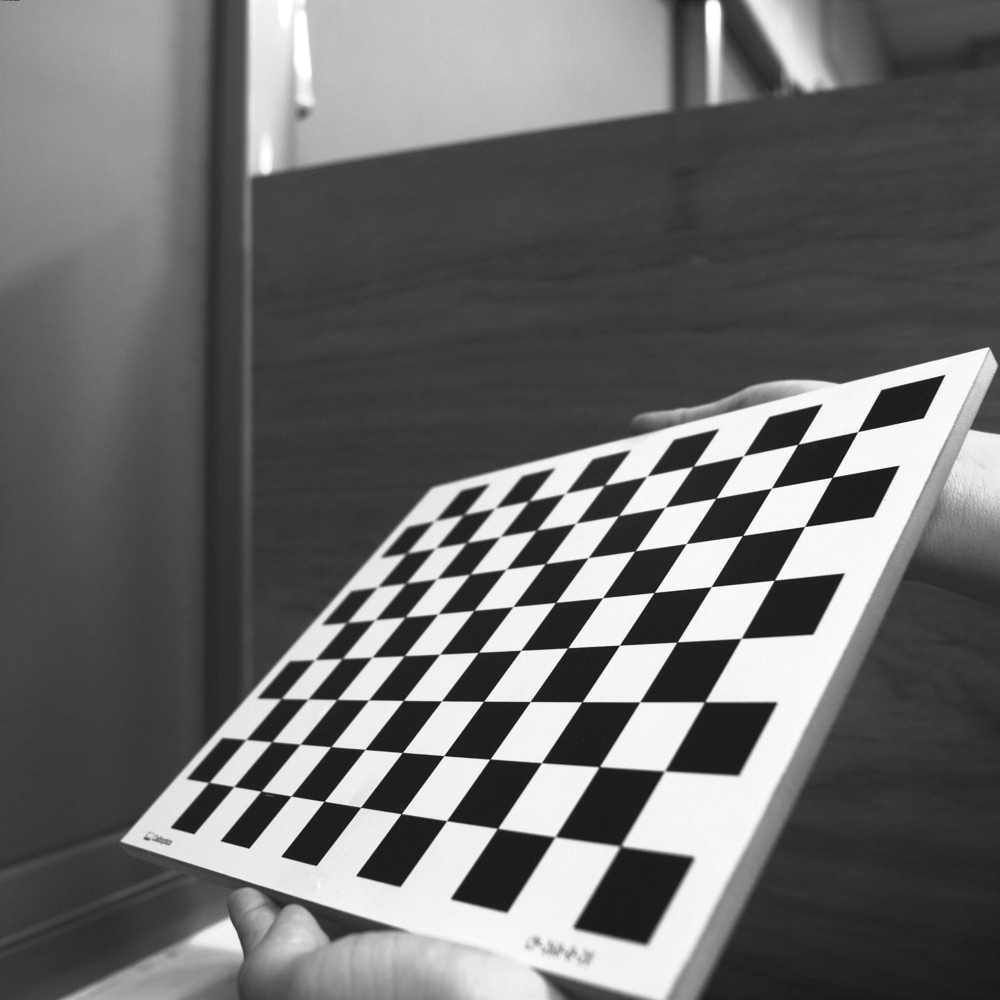
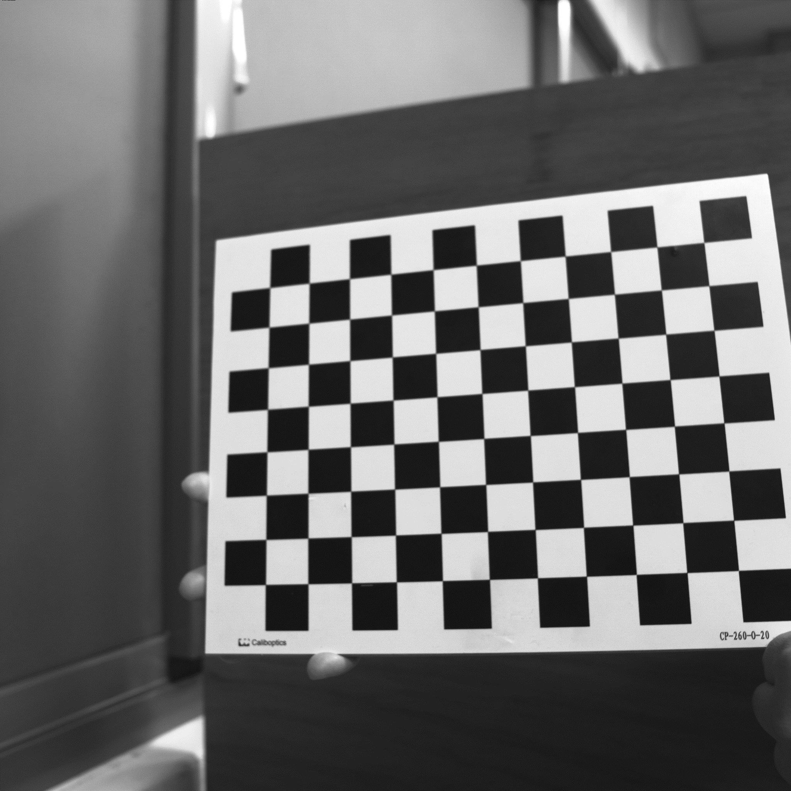
2. (20%) Augmented Reality
(出題： Eric)
Guides and Requirements:
How to use the library: (alphabet_lib_onboard.txt, alphabet_lib_vertical.txt)
Use OpenCV function to read and derive the array or matrix of the char Here take ‘K’ in 'alphabet_lib_onboard.txt' for example e.g. (Python): fs = cv2.FileStorage('alphabet_lib_onboard.txt', cv2.FILE_STORAGE_READ) ch = fs.getNode(‘K’).mat() ➔ get the lines of ‘K’
ch = [[[2, 2, 0], [2, 0, 0]], [[0, 2, 0], [2, 1, 0]],
[[2, 1, 0], [0, 0, 0]]]
‘K’ consist of 3 lines, so the ‘ch array’ consists 3 pairs of 3D coordinates in Word Frame representing two ends of the line shown in the upper right image.
Chessboard Coordinates
The chessboard x, y, z axis and (0,0,0) coordinate are shown in the bottom left image
Each Char should be place in the order and position shown in the bottom right image
(2,2,0)
(0,2,0)
(2,1,0)
(2,0,0)
(0,0,0)
The coordinates are in Word Frame
(0,0,0)
1
2
3
Y
4
5
6
X
Z
Chessboard Frame
Position and Order

Slide 16
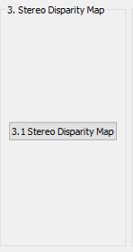
3. (20%) Stereo Disparity Map
(出題：Eric)
3.1 (10%) Stereo Disparity Map
3.2 (10%) Checking the Disparity Value
Load 2 images separately

Slide 17
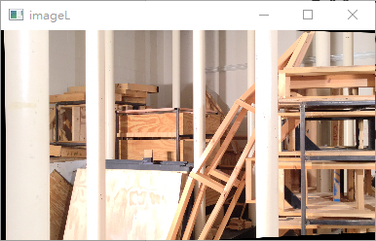
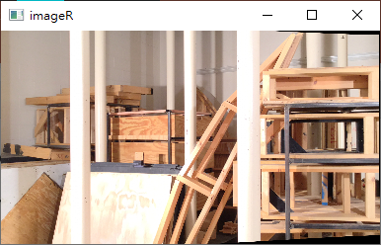
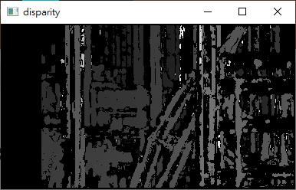
3.1 (10%) Stereo Disparity Map
(出題：Eric)
Given: a pair of images, imL.png and imR.png (have been rectified).
Q: Find the disparity map/image based on Left and Right stereo images
Load imL.png (click “Load Image_L”).
Load imR.png (click “Load Image_R”).
Click button “3.1 Stereo Disparity Map” to show result.
Hint:
Use OpenCV StereoBM class to build StereoBM objects.
stereo = cv2.StereoBM_create(numDisparities=256, blockSize=25)
The above parameters can be freely changed according to the
following rules.
numDisparities: The disparity search range, Must be positive and
divisible by 16. In addition, map disparity range to gray value range 0~255 for the purpose of visualization.
blockSize: The linear size of blocks compared by the algorithm, Must be odd and within the range [5, 50].
Larger block size implies smoother but less accurate disparity map. Smaller block size gives finer disparity
details, yet increase the likelihood of algorithmic misalignment.
If the left image is the reference image (the one used to cal. depth info for each pixel of that Img), then the search direction at right image will go from the right to left direction.
Hint: OpenCV Textbook Chapter 12 (P.451)
StereoBM::create(256, 25)
imL.png
imR.png
Result
Left Image (Reference Image)
Right Image

Slide 18
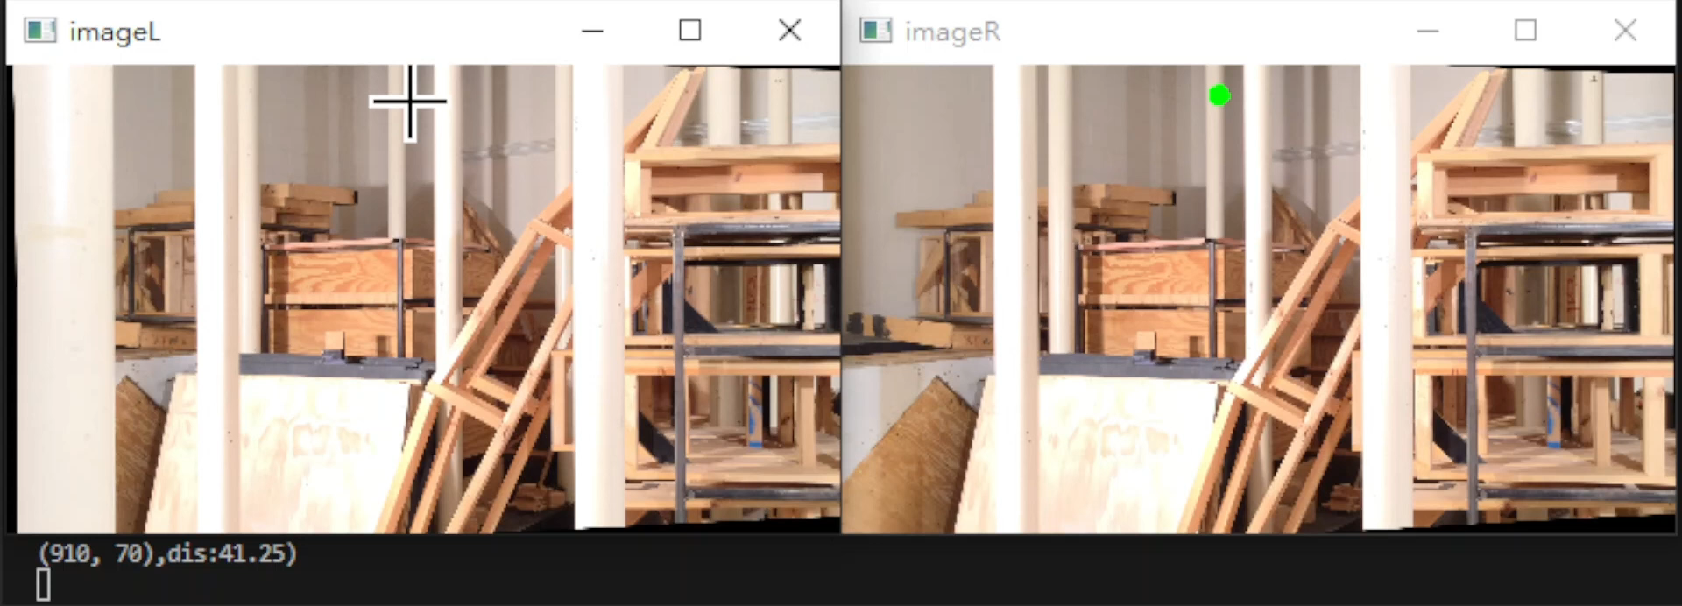
3.2 (10%) Checking the Disparity Value
(出題：Eric)
Given: a pair of images, imL.png and imR.png and disparity map from 3.1
Q: Click at left image and draw the corresponding dot at right image.
Click at left image and draw the dot on the right image at accurate position.
User should be allowed to repeat the action 1).
Hint: Click at gray position at disparity map result from Q3.1, ignore the position with 0 disparity
(e.g. Failure case).
Result Video:
18

Slide 19
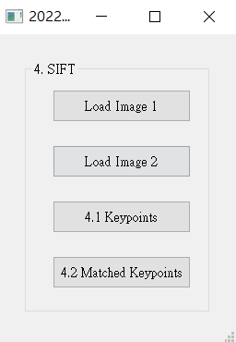
4. (20%) SIFT
(出題：Chen)
4.1 (10%) Keypoints
4.2 (10%) Matched Keypoints

Slide 20
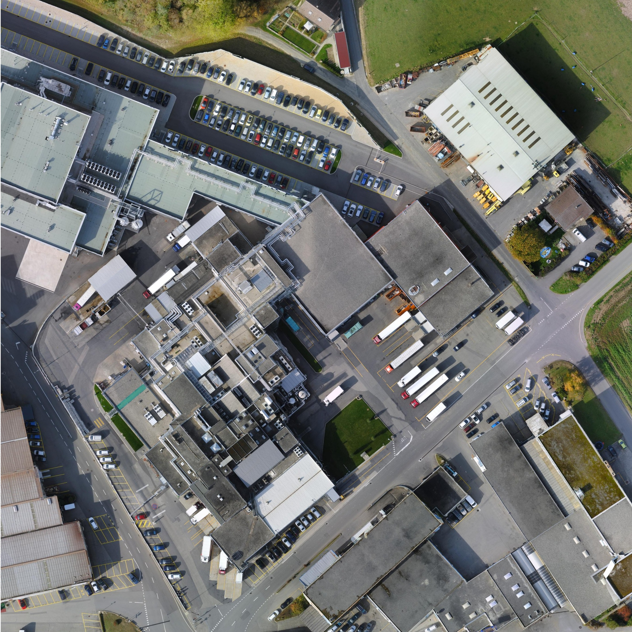
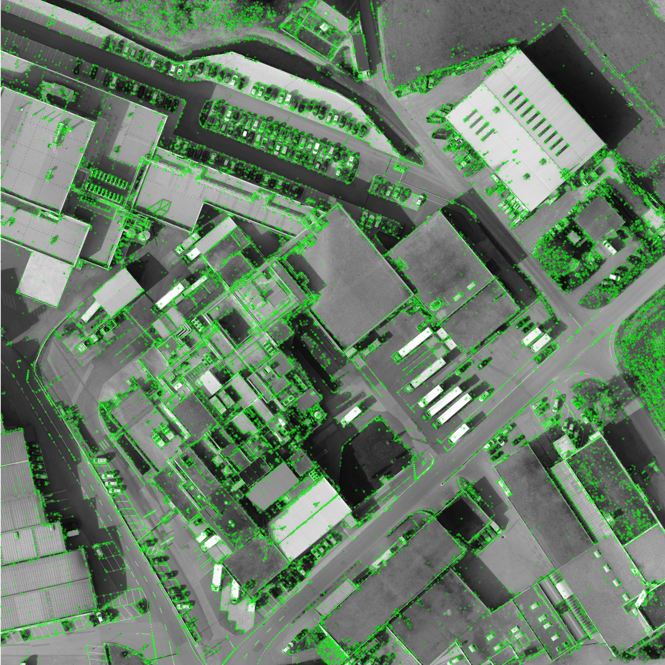
4.1 (10%) Keypoints
(出題：Chen)
Click button “4.1 Keypoints” to show:
Load Left.jpg (click “Load Image 1”)
Based on SIFT algorithm, find key points on Left.jpg.
Hint: Use OpenCV SIFT detector to detect keypoints and descriptors.
sift = cv.SIFT_create() # Create a SIFT detector
sift.detectAndCompute(image,None)
Then draw the keypoints of Left.jpg as I₁.
Hint: cv.drawKeypoints(gray,kp,None,color=(0,255,0))
Please show image I₁
Input:
Output:
Left.jpg
I₁
Reference : OpenCV Textbook SIFT, p321, 464, 524

Slide 21
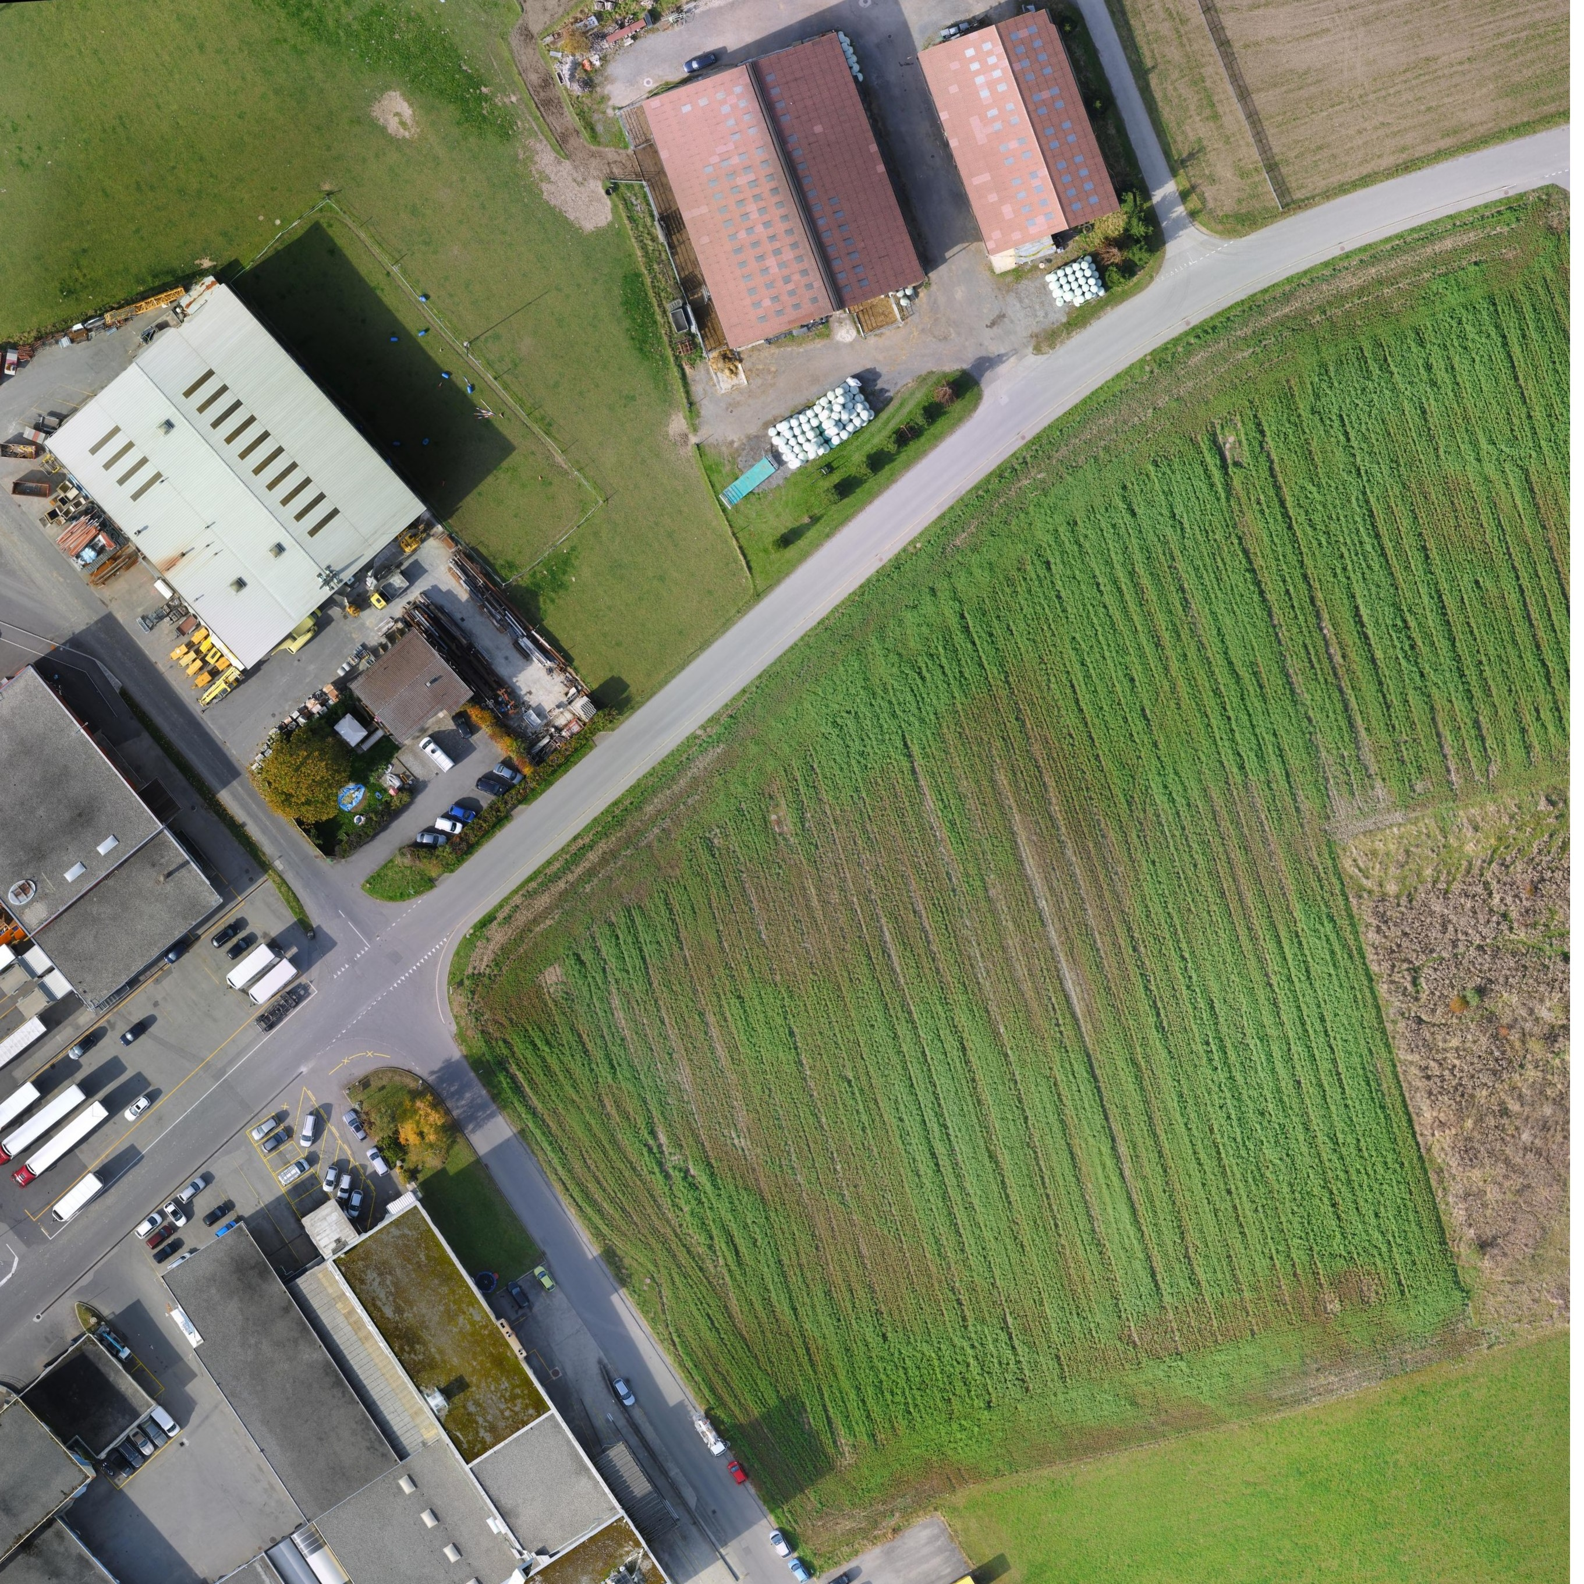
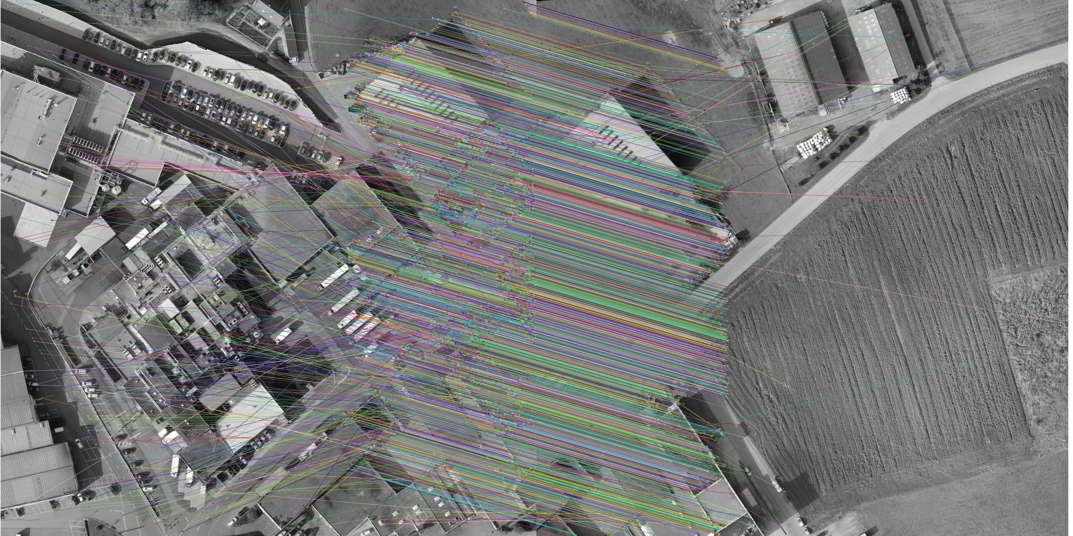
4.2 (10%) Matched Keypoints
(出題：Chen)
Click button “4.2 Matched Keypoints”,
Load Image 1 (Left.jpg) and Image 2 (Right.jpg)
Based on SIFT algorithm, find the keypoints and descriptors at Image 1 and Image 2 (same as question 1)
Find match keypoint of two images
Hint: Use BFMatcher.knnMatch(descriptors 1, descriptors 2,k=2) to locate the matched keypoints.
Extract Good Matches from 3) result:
Hint:
Draw the matched feature points between two image
Hint:. Use “cv2.drawMatchesKnn()” to draw the matches,
for m,n in matches:
if m.distance < 0.75*n.distance:
good.append([m])
cv.drawMatchesKnn(img1,kp1,img2,kp2,mat,good,flags=cv.DrawMatchesFlags_NOT_DRAW_SINGLE_POINTS)
Input:
Output:
Please show image I₂
Left.jpg
Right.jpg
I₂
Reference: OpenCV Textbook SIFT, p321, 464, 524

Slide 22
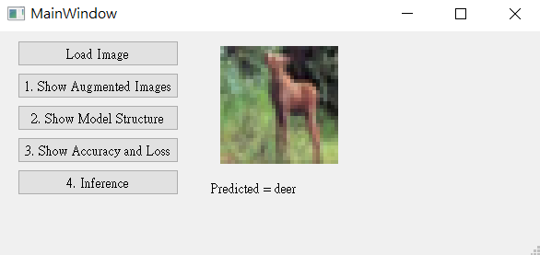
5. Training a CIFAR10 Classifier Using VGG19 with BN (20%)
(出題：Hsiang)
5.1 Load CIFAR10 and show 9 Augmented Images with Labels. (4%)
5.2 Load Model and Show Model Structure. (4%)
5.3 Show Training/Validating Accuracy and Loss. (6%)
5.4 Use the Model with Highest Validation Accuracy to Run Inference, Show the Predicted Distribution and Class Label. (6%)
Figure: GUI example

Slide 23
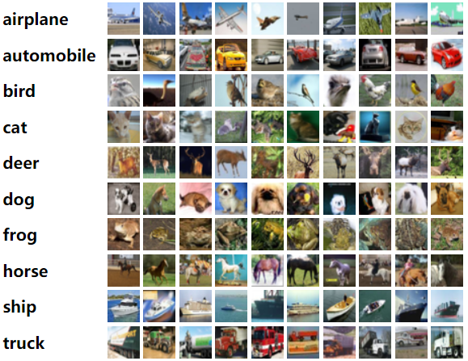
5. Training a CIFAR10 Classifier Using VGG19 with BN (20%)
Objective
Learn how to train a VGG19 with BN (Batch Normalization) model to classify 10 different classes images of CIFAR10.
VGG19 with BN
VGG19: A convolutional neural network that is 19 layers deep.
BN (Batch Normalization): used to make training of artificial neural networks faster and more stable.
CIFAR10
A collection of 60,000 32x32 color images in 10 different classes that is commonly used to train machine learning and computer vision algorithms.
10 classes: airplane, automobile, bird, cat, deer, dog, frog, horse, ship, truck
Datasets
Training dataset: 50000 images in total.
Validation dataset: 10000 images in total.
Testing dataset: 10 images in total. (Generating from validation dataset.)
(出題：Hsiang)
Figure1: CIFAR10
R. Reference
VGG19
Batch Normalization

Slide 24
5. Training a CIFAR10 Classifier Using VGG19 with BN (20%)
Requirements
Train VGG model with batch normalization (BN) using PyTorch.
In the submitted file, you need to include
Weight file for VGG19 with BN in .pth format. (File size is approximately 540MB)
Figure of training/validating loss and accuracy in .jpg or .png format.
Code for your GUI program
Code for model training.
Please do not include image data in the submitted file.
Homework Images
There are 2 different folders in ‘Q5_image’.
In the subfolder ‘Q5_image/Q5_1,' there are 9 different images used in Q5-1. When demoing, use the same images.
In the subfolder 'Q5_image/Q5_4,' there are 9 different images used in Q5-4. These images are used for testing your program. When demoing, we will use different images for the demonstration.
(出題：Hsiang)

Slide 25
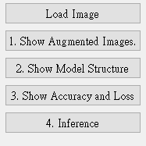
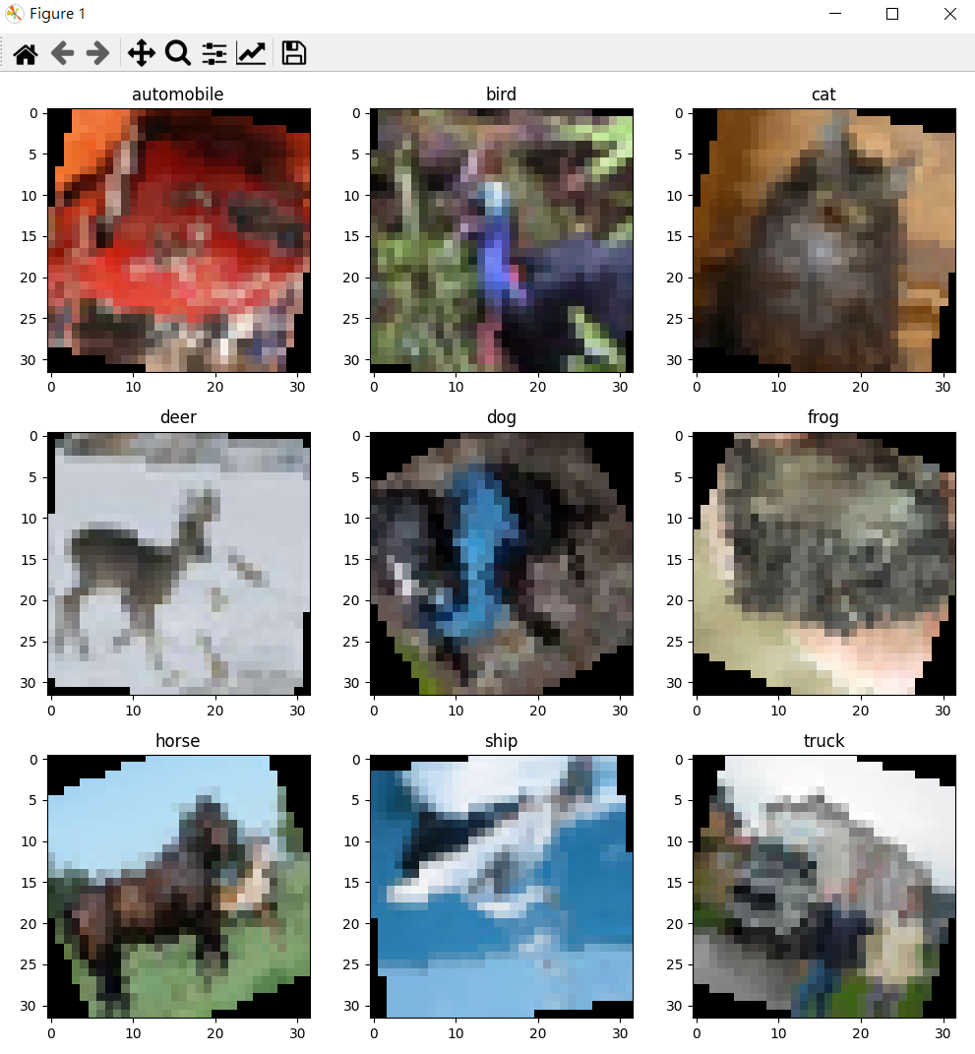
5.1 Show 9 Augmented Images with Labels (3%)
(出題：Hsiang)
Q5.1
At home:
Use PIL.Image.open() to load 9 images in /Q5_image/Q5_1/ folder.
Apply at least 3 different type of data augmentation (tutorial).
transforms.RandomHorizontalFlip()
transforms.RandomVerticalFlip()
transforms.RandomRotation(30)
When the demo:
Click the button “1. Show Augmentation Images”
Load 9 images in /Q5_image/Q5_1/ folder
Apply data augmentation on 9 images.
Show 9 augmented images with label in a new window.
Notice: This is an example; you can use different data augmentation techniques
Figure1: 9 Augmented images Notice: this is an example, the
images might differ

Slide 26
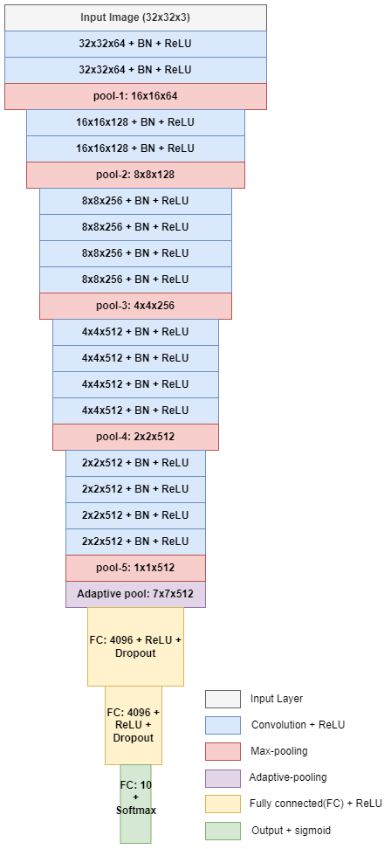
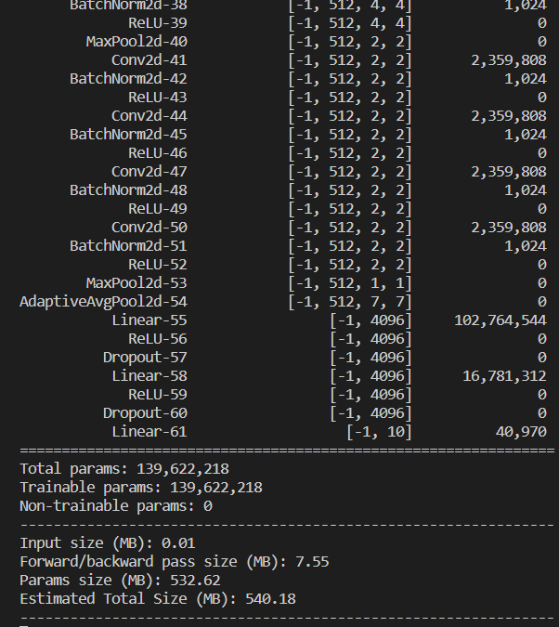
5.2 Show the Structure of VGG19 with BN (3%)
(出題：Hsiang)
Q5.2
At home:
Use torchvision.models.vgg19_bn(num_classes=10) to build a VGG19 with batch normalization (BN) model.
Use torchsummary.summary to show the structure in the terminal.
When the demo:
Click the button “2. Show Model Structure”
Run the function to show the structure in the terminal.
The -1 indicates that the actual size of batch size can vary.
Feature map shape
(Batch, Channels,
Height, Width)
Layer (type)
Num. of param.
All convolution filter size is 3x3
Flatten Here
Figure: the Structure of VGG19 with BN
Figure: VGG19 with BN model structure

Slide 27
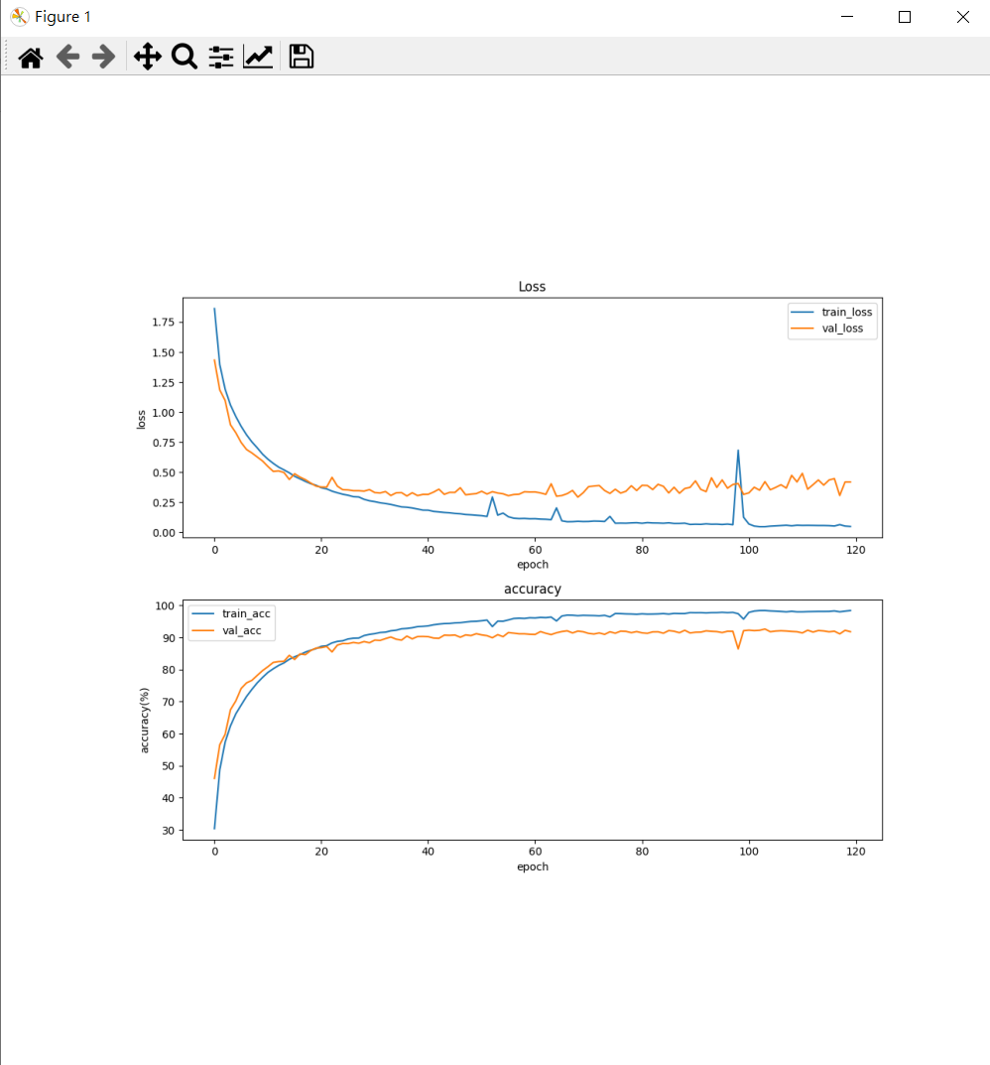
5.3 Show Training/Validating Accuracy and Loss (6%)
(出題：Hsiang)
Q5.3
At home:
Use torchvision.datasets.CIFAR10 to load the training and validation datasets. (tutorial)
Training and validating VGG19 with BN at least 40 epochs at home (tutorial) and record the training/validating accuracy and loss in each epoch (tutorial).
Notice: If your validation accuracy is low, you can try
Adjust the learning rate of the optimizer.
Change the data augmentation techniques used.
Save weight file with highest validation accuracy .
Use matplotlib.pyplot.plot() to create a line chart for the training and validating loss and accuracy values.
Save the figure
When the demo:
Click the button “3. Show Accuracy and Loss”
Show the saved figure of Training/Validating loss and accuracy in a new window
(2) Show the figure in a new window
(1) Click the button.
Notice: this is an example, the number of epoch might differ

Slide 28
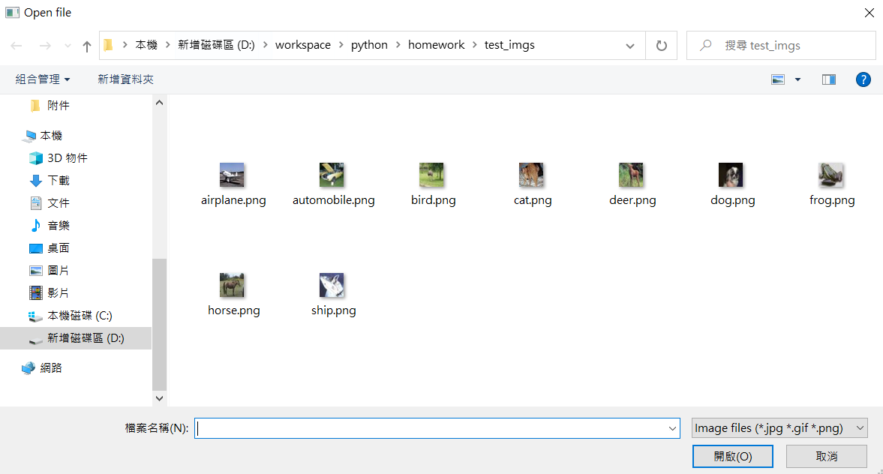
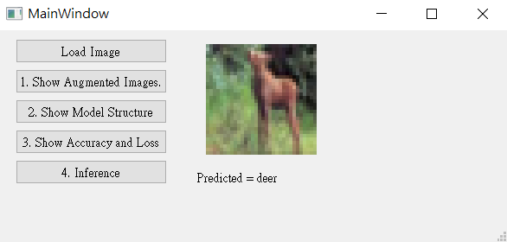
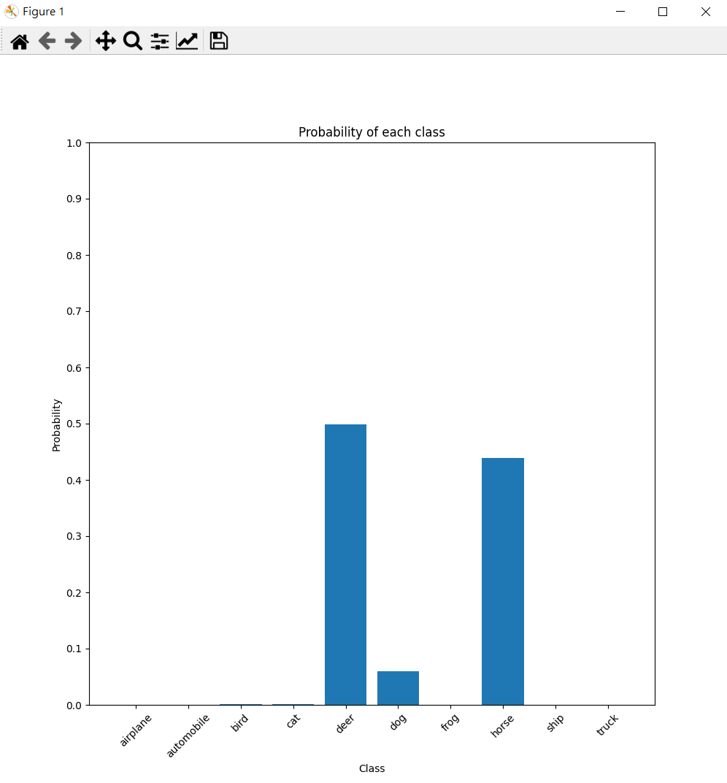
5.4 Use the Model with Highest Validation Accuracy to Run Inference, Show the Predicted Distribution and Class Label. (6%)
(出題：Hsiang)
Q5.4
At home:
Load the model which trained at home
Click the button “Load Image” to display a new file selection dialog
Select 1 image arbitrarily.
Show the loaded image on the GUI. (In order to make it visually clear on the UI, use QtGui.Qpixmap.scaled to scale the image to 128x128 when displaying it.)
Click the button “4. Inference” to run inference on the image. (tutorial)
Show the predicted class label on the GUI.
Show the probability distribution of model predictions using a histogram in a new window.
When the demo: repeat the process
(3) Select 1 image arbitrarily
(2) Click the button.
(4) Show the loaded image (When displaying loaded image, resizing the loaded image to 128x128)
(6) Show the predicted class label
(5) Run inference on the loaded image
(7) Show the probability distribution of model prediction in new window.

Slide 29
5.4 Use the Model with Highest Validation Accuracy to Run Inference, Show the Predicted Distribution and Class Label. (6%)
(出題：Hsiang)
The probability distribution of model prediction using a histogram.
Y-axis: probability
X-axis: class name

Slide 30
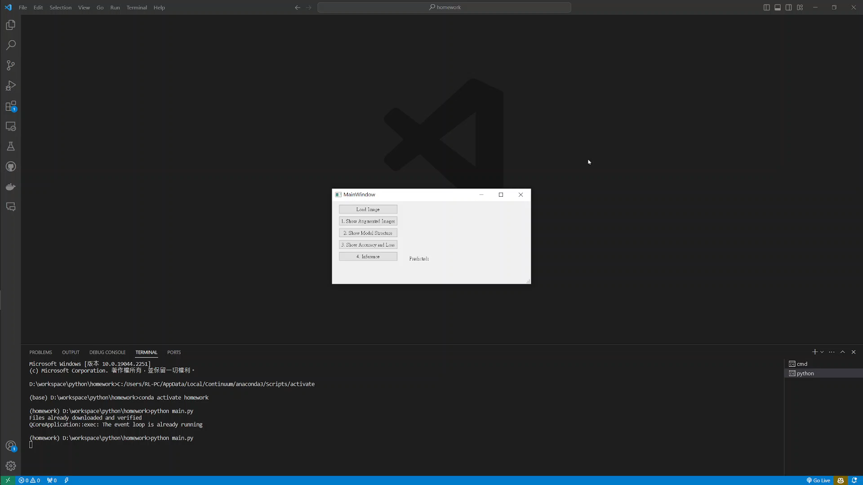
5. Training a CIFAR10 Classifier Using VGG19 – Example Video
(出題：Hsiang)
This is an example illustrating the objectives from 5.1 ~ 5.4.

